Slide 1

Mid Term Presentation Fabrication and Prototyping in the LearningLab
Gunakar Challa

Slide 2
Global Concept – Surveillance Robot
The idea is to have a robot which can do surveillance on a private area.
It shall recognise any unauthorized personnel or intruders while doing the surveillance and report the incident to security administrators.
It shall then follow the intruders and alert them.
Furthermore, if the security admin wishes to take on the control of the robot, he shall be able to do that as well.
Applications:
Where the area of surveillance is too large.
Where the temperatures are extremes and not suitable for humans.
Where the manual surveillance is not economically feasible.

Slide 3
Prototype Concept
We shall attach a Raspberry Pi4B to the PMB2 robot. The logic to go through the surveillance area runs on Pi 4B.
We shall also use Coral USB accelerator to run the machine learning model to detect the humans.
While doing the surveillance, when it detects any humans, it goes towards the humans and stops at a distance using sonar sensor. It sends out an alerting sound via speaker attached to Pi 4B.
The Pi4B also sends the signal to the admin using Blynk cloud and the admin can control the robot using Blynk dashboard.

Slide 4
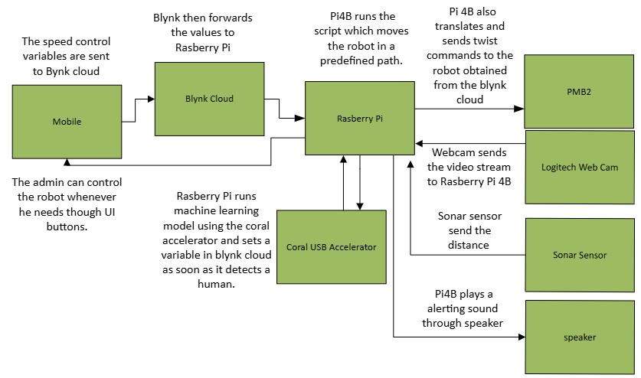
Prototype Architecture

Slide 5

Prototype Logic
Pi 4B runs the path script which sends the twist commands to the PMB2 robot.
The detection script runs parallelly to path script. It takes the video feed from the webcam and runs machine learning model to detect humans.
The moment it detects humans, it goes into program loop wherein it follows the human. The loop can be constructed as follows:
While it sees humans:
Start:
Go forward until the distance calculated through sonar is less than 50 cm.
Transmit the alert signal to admin
Play alerting sound using speaker.
delay of 5 seconds.
If the human is missing:
Rotate clockwise/anticlockwise until human is found and go to start if found again
If completed 360 degrees then continue on predefined path

Slide 6

Progress Made till now
Initial Set up of Raspberry Pi 4B
Running machine learning model on Pi 4B
Playing sound through speaker using playsound library

Slide 7
Further process
Write code send twist commands to PMB2 for initial pretrained route
1
Write code to follow the human and send alerting messages to admin and intruder
2
Prepare blynk UI for mobile
3
Setup blynk cloud
4
Prepare the base to hold Pi 4B, sonar sensor on top of the PMB2.
5
Modify to use coral USB accelerator
6

Slide 8

Discussion

